Slide 1
TechPlement –Week 1 Task Quiz Generator
This Java application allows users to create, manage, and take quizzes through a text-based interface. Users can interact with the system to create quizzes, add questions, and take quizzes, with scores and feedback provided at the end.

Slide 2
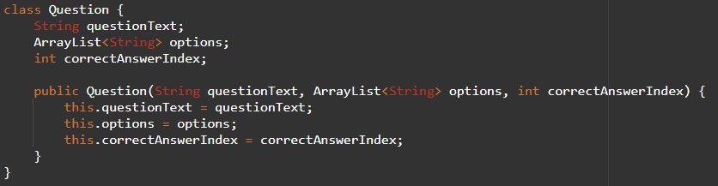
Question Class
Question Class
Represents a quiz question with the following attributes:
questionText: The text of the question.
options: A list of possible answers.
correctAnswerIndex: The index of the correct answer in the options list.

Slide 3
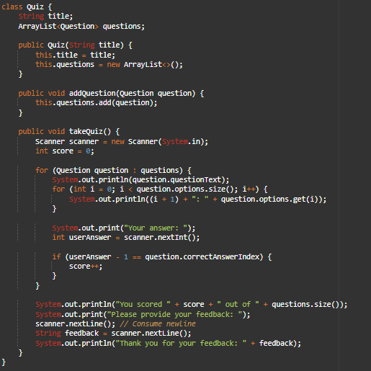
Quiz Class
Quiz Class
Represents a quiz with the following attributes:
title: The title of the quiz.
questions: A list of Question objects.
Methods:
addQuestion(Question question): Adds a Question to the quiz.
takeQuiz(): Presents the quiz to the user, collects answers, scores the quiz, and collects feedback.

Slide 4
Command List (Main Menu Commands)
1. Create a new quiz
Prompts for the quiz title.
Adds a new quiz with the specified title to the list of quizzes.
2. Add a question to a quiz
Lists available quizzes.
Prompts to select a quiz by its index.
Prompts for the question text.
Prompts for the number of options (minimum 2).
Prompts to enter each option text.
Prompts to enter the number of the correct answer.
Adds the new question to the selected quiz.
3. Take a quiz
Lists available quizzes.
Prompts to select a quiz by its index.
Presents each question in the selected quiz.
Collects answers, scores the quiz, and displays the score.
Prompts for feedback and displays it back to the user.
4. Exit
Exits the application

Slide 5
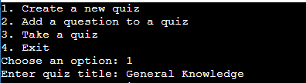
1. Create a New Quiz
Command: 1
Steps:
Enter 1 and press Enter.
Enter the quiz title and press Enter.

Slide 6
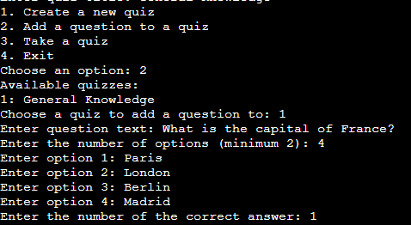
2. Add a Question to a Quiz
Command: 2
Steps:
Enter 2 and press Enter.
Select a quiz from the list by entering its index and pressing Enter.
Enter the question text and press Enter.
Enter the number of options (minimum 2) and press Enter.
Enter each option text, pressing Enter after each one.
Enter the number of the correct answer (index) and press Enter.

Slide 7
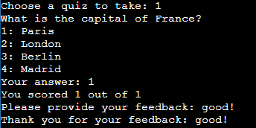
3.Take a Quiz
Command: 3
Steps:
Enter 3 and press Enter.
Select a quiz from the list by entering its index and pressing Enter.
Answer each question by entering the number corresponding to the chosen option and pressing Enter.
After all questions are answered, view the score.
Enter feedback and press Enter.

Slide 8
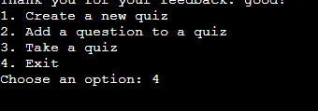
4.Exit
Command: 4
Steps:
Enter 4 and press Enter to exit the application.

Slide 9
THANK YOU

